Slide 1
HSC 509: Perspectives on Human Behaviour
Prof. Sathya Narayana Sharma

Slide 2
Reading Material
Mind-body problem: http://www.scholarpedia.org/article/Mind-body_problem:_New_approaches
Biology of Behaviour: Gross, Psychology The Science of Mind and Behavior. Chapter 4.
Consciousness: Chapter 7.
Cognition: http://www.scholarpedia.org/article/Cognitive_psychology
Dual Process Model: Kahneman, Thinking, Fast and Slow. Summary: https://theartofliving.com/wp-content/uploads/2022/04/Thinking-Fast-and-Slow-PDF-Summary.pdf

Slide 3
Debates in Psychology: Mind-body problem
How can physical and mental be related?
René Descartes (1596–1650).
Matter - Spatial - Dimensionality
Mind - Consciousness
How do body and mind interact?

Slide 4
Dualism - Mind and brain are made up of different kinds of substance (Descartes). Interacts at Pineal gland.
Mental Properties:
being in pain
tasting the taste of chocolate
wanting the semester to be over
feeling sad
Not mental properties:
stubbing your toe
screaming "ouch"
saying, "Damn, I can't wait for the semester to be over"
frowning

Slide 5
Idealism: There is only mind, and matter is merely a manifestation of mind.
Panpsychism (all objects of experience have minds)
Epistemological idealism (minds are aware of or perceive only their own ideas, not external objects)

Slide 6
Physicalism: Universe is physical. Mind is created by some extremely subtle (and as yet unknown) mechanism of action between suitable physical components.
Supervenience: If two persons are indistinguishable in all of their physical properties, they must also be indistinguishable in all of their mental properties.
Reductionism: Mind-based concepts will eventually be replaced by neuroscientific concepts (Churchland, Crick).
Emergentism: Mind is proposed to arise through an emergent process from underlying physical activity in matter. Knowledge argument.

Slide 7
Dual-aspect theory - Mind and brain are two levels of description of the same thing (Spinoza).
Reality has two properties: thought (consciousness) and extension.
What is the underlying reality? Spinoza called it existence or being.

Slide 8
Biology of Behaviour

Slide 9
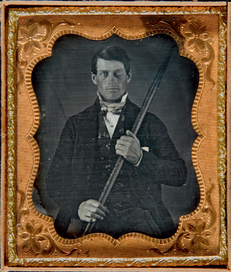
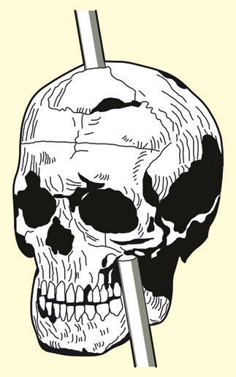
Biology of Behaviour: The Brain & Nervous System
The case of Phineas Gage
“… irreverent, indulging at times in grossest profanity ... manifesting but little deference for his fellows, impatient of restraint or advice when it conflicts with his desires ... devising many plans of future operation, which are no sooner arranged than they are abandoned in turn for others.”

Slide 10
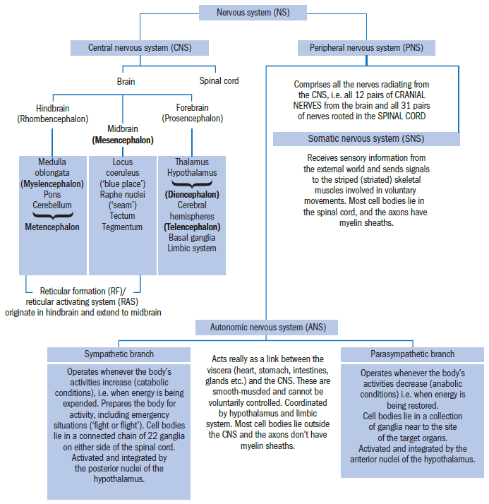

Slide 11
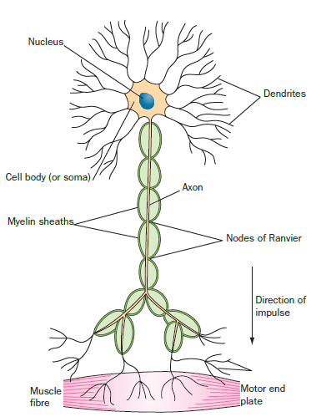
Neurons
Three kinds:
1. Sensory (afferent)
2. Motor (efferent)
3. Interneurons (connector)
Dendrite 🡪 Cell body 🡪 Axon 🡪 Axon terminals.

Slide 12
Action Potential
Resting state of neuron: Resting potential.
The electrochemical signal that passes down the axon is called an action potential.
An action potential is generated within a neuron when sufficient signal is received by it from adjacent neurons.

Slide 13
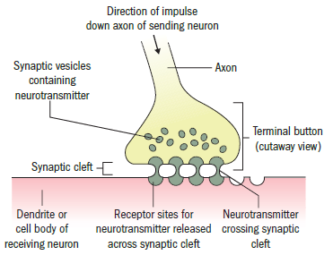
Neuronal Communication
Terminal buttons 🡪 Synaptic vesicles 🡪 Neurotransmitter 🡪 Synaptic cleft 🡪 Receptor sites of dendrite.

Slide 14
Excitatory vs Inhibitory synapses
Firing of one neuron does not necessarily lead to firing of the adjacent neuron.
It can also instruct the next neuron to not fire.
Depends on the synapse characteristic.
Important to keep the neural activation in the appropriate networks (failing may cause epileptic seizures).

Slide 15
Neurotransmitters
Whether a synapse is excitatory or inhibitory depends on the neurotransmitter contained in the synaptic vesicle.
Receptor site is precisely tailored to match the shape of the transmitter molecule.
The effect of neurotransmitter ends in the process of:
deactivation (where it’s destroyed by special enzymes) or
by reuptake (where it’s pumped back into the presynaptic axon, either for destruction or recycling).

Slide 16
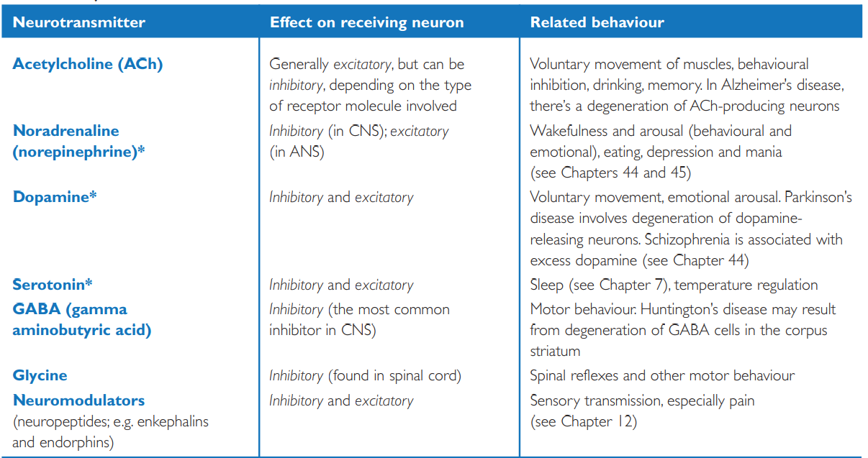

Slide 17
Psychoactive drugs
The process of neurotransmission is the main target of drugs and medications that affect mood and cognition.
Selective serotonin reuptake inhibitors (depression)
Reuptake inhibitors of norepinephrine and dopamine (ADHD)
Alcohol: Increases activity of GABA 🡪 decreases CNS activity.
Caffeine : Prevents “adenosine” from binding to its receptor.

Slide 18
Methods of studying the brain
Clinical methods – Studying patients who had suffered brain damage from accidents/strokes.
Invasive methods – Surgically damaging/stimulating brain areas.
Non-invasive methods:
EEG
MRI /fMRI
TMS

Slide 19
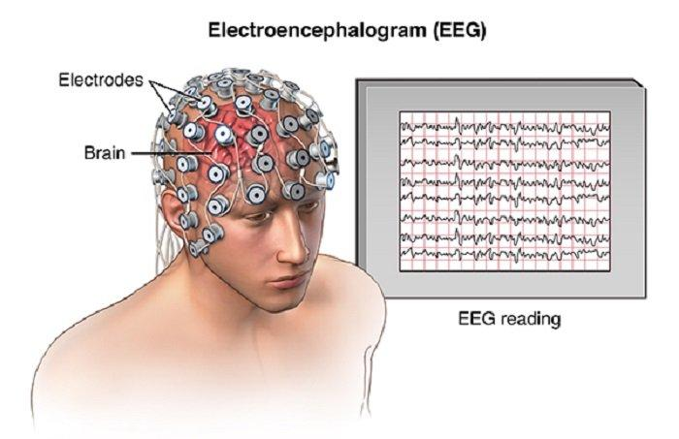
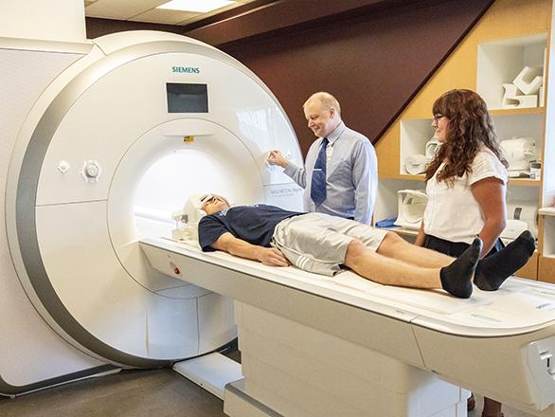
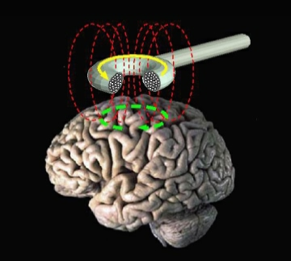
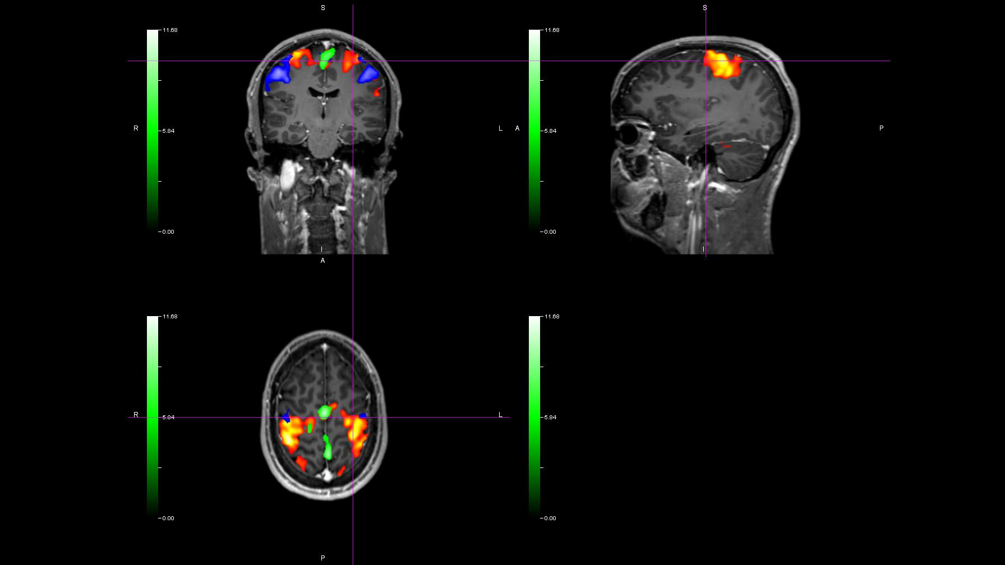

Slide 20
The Major Structures and Functions of the Brain
Forebrain
Cerebrum
Thalamus
Hypothalamus
Basal Ganglia
Limbic system
Midbrain
Hindbrain
Cerebellum
Pons
Medulla oblongata

Slide 21
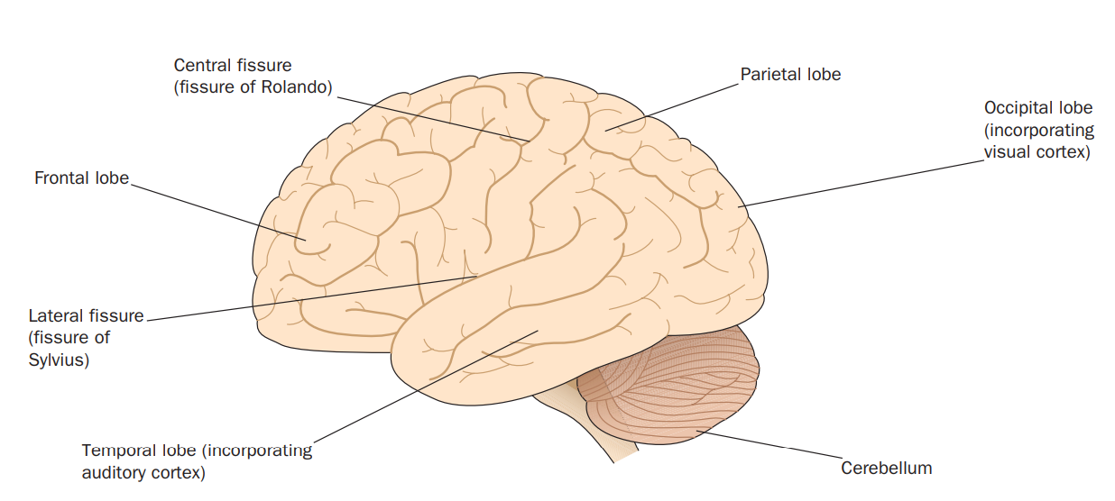
Cerebrum
Largest structure at the top of the brain.
Divided into two hemispheres by corpus callosum.
Four lobes.
Cortex: grey matter
White matter

Slide 22
Cerebrum (cont.…)
Occipital lobe (primary visual cortex).
Temporal lobe (primary auditory cortex)
Parietal lobe (primary somatosensory cortex)
Frontal lobe (primary motor cortex)
Primary sensory and motor areas: 25%
Association areas: 75%

Slide 23
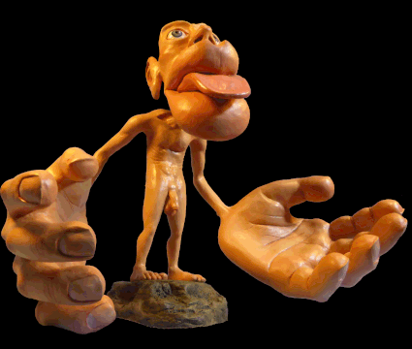
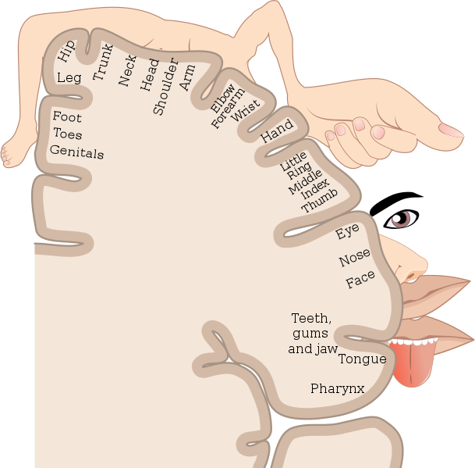
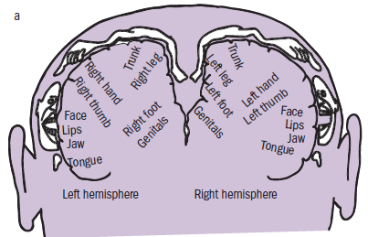

Slide 24
Broca’s area – speech production – left frontal lobe
Wernicke’s area – speech comprehension – left temporal lobe
Broca’s and Wernicke’s aphasia
https://www.youtube.com/watch?v=JWC-cVQmEmY&t
https://www.youtube.com/watch?v=3oef68YabD0&t

Slide 25
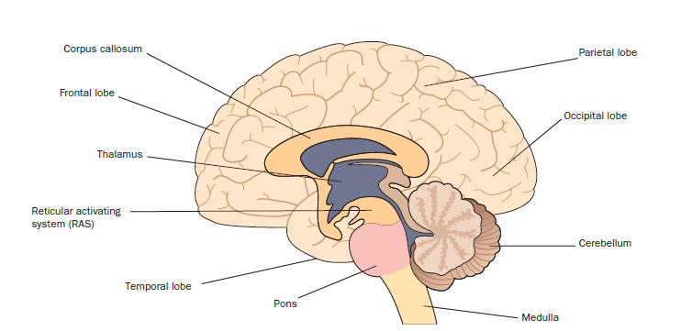
Thalamus
Sensory relay station
Transmits them to appropriate areas of the cortex.
Also receives information from the cortex, dealing with complex limb movements, which are directed to the cerebellum.

Slide 26
Hypothalamus
Major functions: Homeostasis, Motivation
Water balance, hunger, heat control, aggression, sex drive.
Fight or Flight response
Removal of only cortex but not hypothalamus causes “sham rage”
Removal of cortex and hypothalamus cause lack of defensive behaviour.
Affects behaviour directly through ANS, and through pituitary gland.

Slide 27
Basal ganglia
Coordinates voluntary muscle movement.
Receives information from the cortex and relays it to brainstem and cerebellum.
Makes motor movements smooth and posture steady.
Parkinson’s disease associated with basal ganglia.
Jerky movements and tremors.

Slide 28
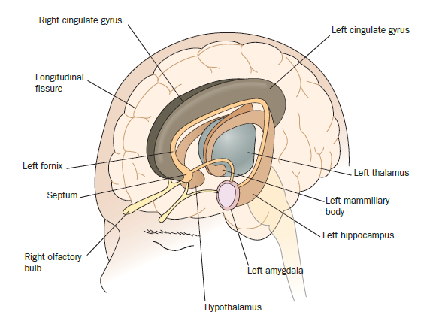
Limbic system
Set of interconnected structures - motivational and emotional needs, feeding, fighting, escape and mating.
Septum, amygdala, hippocampus, portions of hypothalamus and cortex.
Septum - pleasure center.
Amygdala - defensive and aggressive behaviour, emotional learning.
Hippocampus - learning and memory.

Slide 29
Midbrain
Reticular formation
Regulates arousal and alertness.
Visual and auditory reflexes - orienting reflex.

Slide 30
Hindbrain
Cerebellum
Voluntary muscle activity
Posture, Fine movements
Pons
Connects medulla with cortex
Medulla oblongata
Oldest structure of the brain
Controls breathing, heartbeat, blood pressure, swallowing.

Slide 31
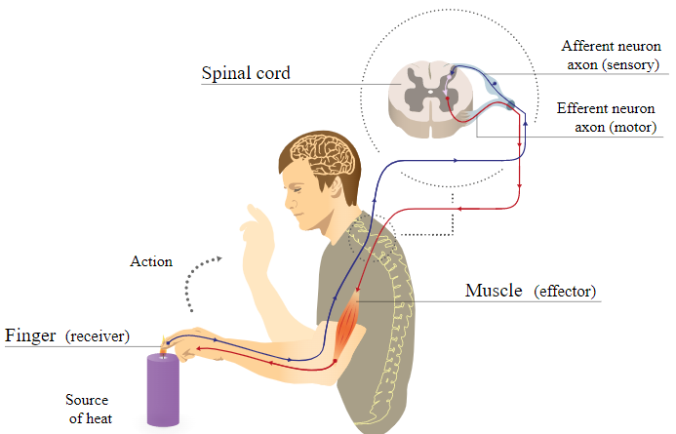
Spinal cord
Communication channel between CNS and PNS.
Reflex arc.

Slide 32
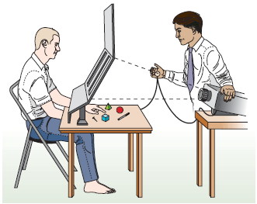
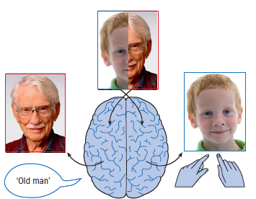
Split-brain?
Sensory areas are located in both hemispheres.
Language is lateralized - especially higher-order processes.
Both hemisphere required for integrated experience.

Slide 33
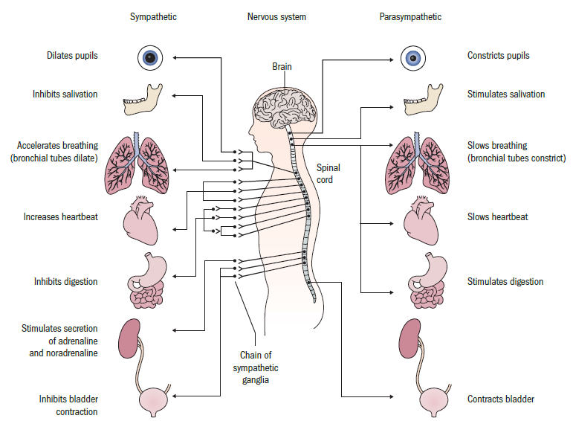
Autonomic Nervous System

Slide 34
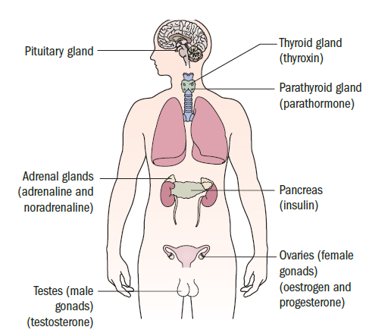
Endocrine System

Slide 35
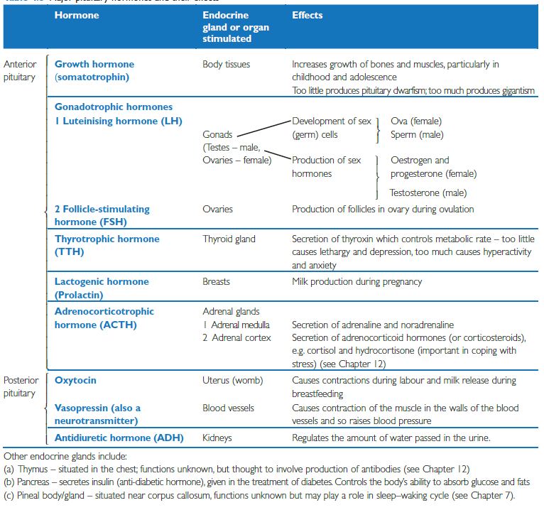

Slide 36
Consciousness

Slide 37
What is Consciousness?
Ability to experience sensations of pain, cold, hunger, fear, and so on.
Ability to experience of one’s own individuality, the ability to experience oneself as an autonomous individual with subjective feelings - Self-consciousness.
Awake vs Sleep / Anesthesia / Coma
Conscious/deliberate vs automatic action.
Public consciousness.
The fact of subjectivity.

Slide 38
Consciousness and Arousal
Tonic alertness
Related to biological rhythms
Over a 24 hr period
Reticular Activation System
Phasic alertness
Short term variations in alertness
In response to novel stimuli - orienting response.

Slide 39
Consciousness and Attention
Focal attention - what is at the center of awareness.
Limited capacity
Peripheral attention
How much psychological activity is governed by processes that we are/can be aware of?
Nisbett & Wilson (1977) - Halo effect.

Slide 40
Purpose of Consciousness?
Does behavior require consciousness?
Is consciousness essential for intention, imagination, planning, thought, short-term memory, attention, metacognition, emotion?
Adaptive function in enabling non-reflexive (flexible responses) behaviour?

Slide 41
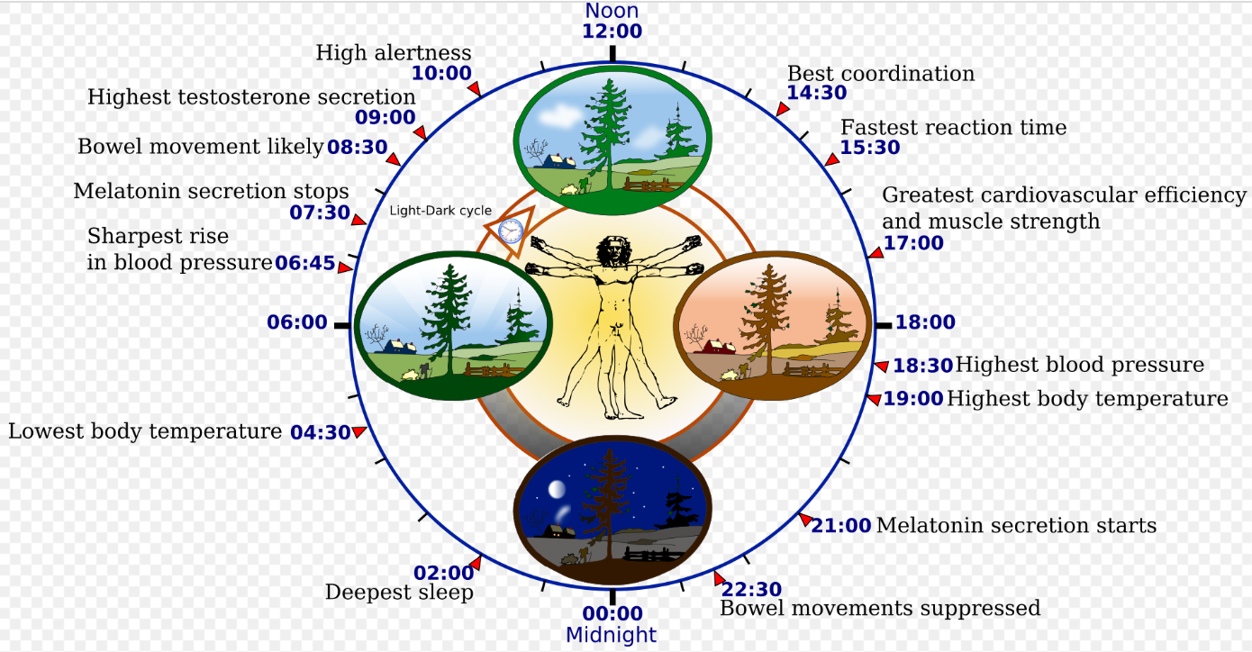
Sleep and Circadian Rhythm
Physical, mental, and behavioral changes that follow a 24-hour cycle.
Controlled by suprachiasmatic nucleus.
Situated above optic chiasma.

Slide 42
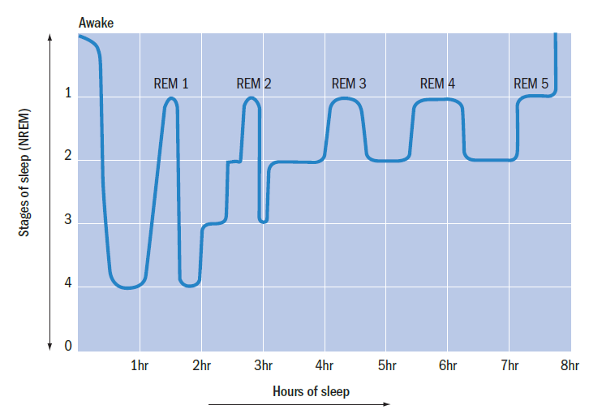
Physiology of Sleep
Eyes (darkness) → Pineal Gland → Melatonin → Drowsiness
Melatonin → Serotonin at raph nuclei (pons) → RAS → Sleep
NREM (4 stages) vs REM

Slide 43
Function of Sleep
Evolutionary Theory
Conserve energy and keep the organism out of danger.
That sleep deprivation is fatal argues against this theory.
Restoration
Reduced rate of metabolism during NREM enables restorative processes especially in the brain.
Memory Processing
Declarative memory improves more during NREM while procedural memory during late sleep REM.
Hippocampal replays of previously encoded neural patterns during NREM facilitate long-term memory consolidation.

Slide 44
Dreaming
Threat simulation hypothesis
Activation-synthesis hypothesis
REM is activated by acetylcholine mechanism in brain stem.
Forebrain attempts to piece together (synthesise) the meaningless, apparently random images, thoughts and feelings that are thrown up by the brainstem.
Dreams are epiphenomena.

Slide 45
Cognition

Slide 46
Historical Perspective
Behaviourism
Behaviors are learned through interaction with the environment - conditioning (Classical and Operant).
Behaviorism is only concerned with observable stimulus-response behaviors.
Internal mental events could not be used to explain behavior.

Slide 47
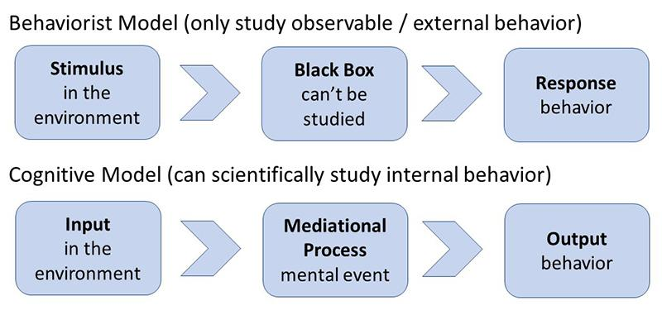

Slide 48
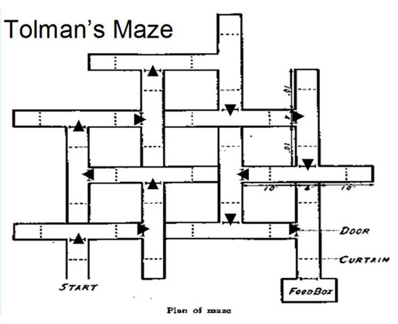
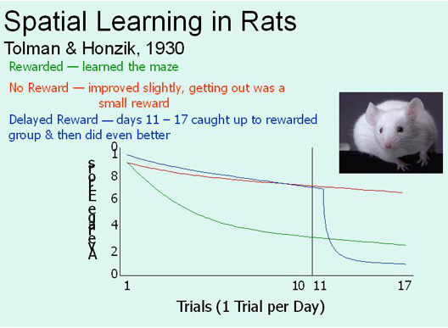
Challenges to Behaviourism

Slide 49
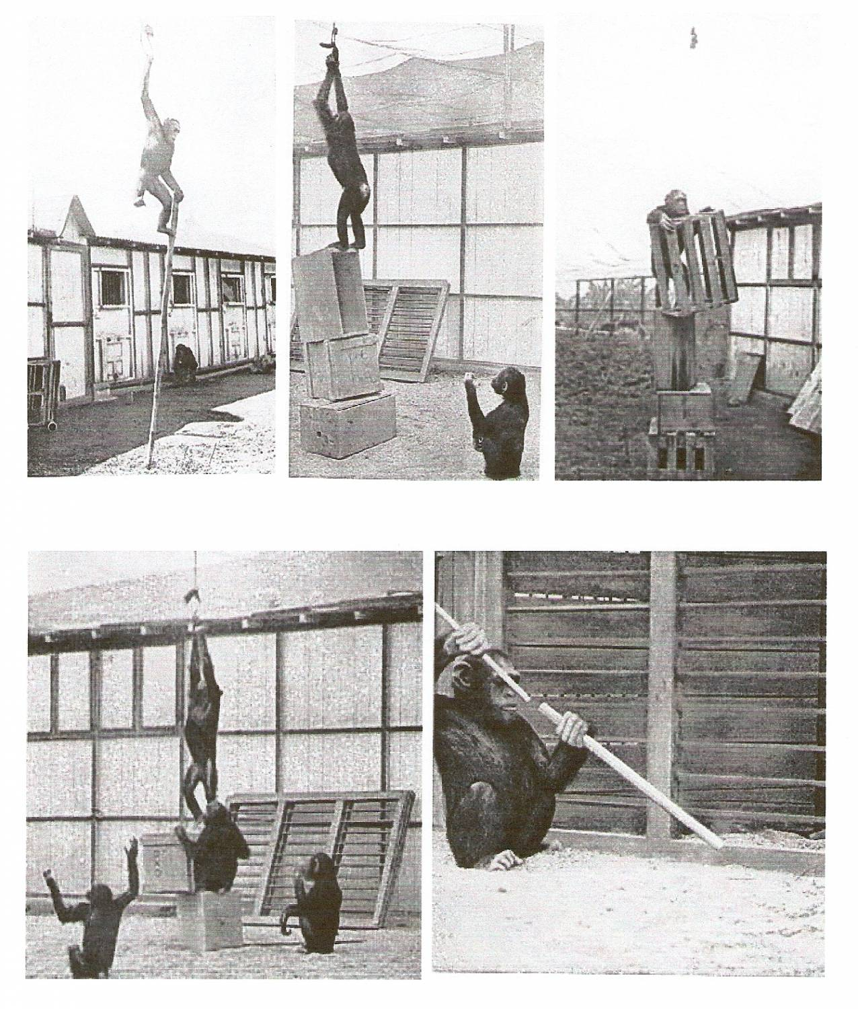
Kohler’s learning by insight

Slide 50
Chomsky’s critique of behaviorism
Behaviourism cannot account for language acquisition and use.
According to Chomsky, we can acquire language because we’re genetically encoded with a universal grammar — a basic understanding of how communication is structured.

Slide 51
Main Ideas
Cognitive psychology studies how people acquire, process, transform, store and apply knowledge or information.
Explicitly acknowledges the existence of internal mental states (such as belief, desire, and motivation), unlike behaviorism.

Slide 52
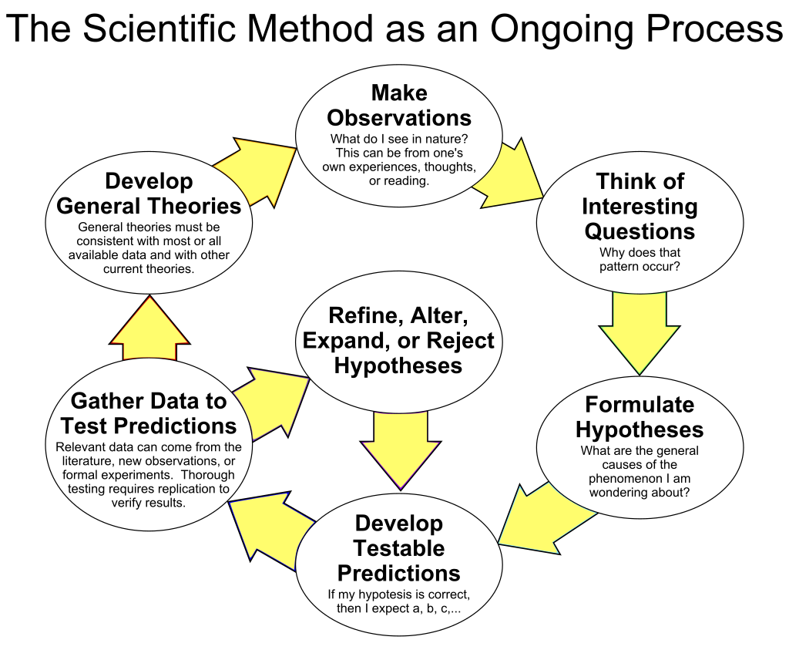
Human cognition can at least in principle be fully revealed by the scientific method, that is, individual components of mental processes can be identified and understood.

Slide 53
Humans can only interact with the "real world" through intermediary systems that process information like sensory input.
The study of cognition is the study of these systems and the ways they process information from the input.
Processing includes not just the initial structuring and interpretation of the input but also the storage and later use.
Bridges the gap between the physical world and the world of ideas, concepts, meanings and intentions.

Slide 54
Approaches in studying cognition
Experimental cognitive psychology
Psychophysics
Reaction time
Eyetracking
Computational cognitive psychology
Develops formal mathematical and computational models of human cognition.
Neural cognitive psychology (Cognitive neuroscience)
Uses brain imaging and lesion studies to understand the neural basis of cognition.

Slide 55
Sub-domains of Cognitive Psychology
Perception
Attention
Memory
Concept formation
Decision making
Language

Slide 56
Dual Process Model

Slide 57
Historical Perspective
Framework used to explain how people think and make decisions.
William James: Two different kinds of thinking - associative and true reasoning.
Kahneman: System 1 and System 2 (Thinking Fast and Slow).
System 1 is evolutionarily older, more automatic, instinctive, implicit and unconscious.
System 2 is evolutionarily newer, intentional, effortful, explicit and conscious.

Slide 58
System 1 is impulsive, fast, emotional and acts without thinking – but relies on heuristics and past knowledge/experience.
System 2 is a more cognitive, deliberate, thinking process which can take in a greater range of data than just our own experience.

Slide 59
System 1 lets us respond quickly and instinctively to a wide range of fast and ever-changing inputs.
System 2 is more thorough and logical but also slower and more resource intensive.
System 1 takes care of low-level tasks.
System 2 takes over when System 1 fails because of difficulty, time pressure, or novelty.
This is an efficient and effective way for our minds to operate because we have limited mental energy.

Slide 60
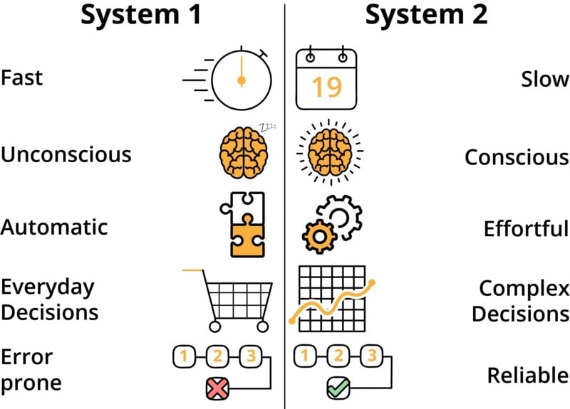

Slide 61
Mistakes happen when switching to System 2 doesn’t happen appropriately.
This makes us fall back on the learned behaviors and shortcuts (‘heuristics’) of System 1.
This leads to cognitive biases that sabotage thinking and decision making.

Slide 62
Cognitive Ease
A bat and ball cost $1.10. The bat costs one dollar more than the ball. How much does the ball cost?
Biases happen when complex information (requiring System 2) is presented in ways that make problems look easier than they really are (falling back on System 1).
A good mood can also fool us into a state of cognitive ease.

Slide 63
Confirmation Bias
Tendency to favor facts that support our existing conclusions and unconsciously seek evidence that aligns with them.
System 1 tends to prioritise evidence that supports pre-existing ideas. It will also discount evidence that contradicts them.
Halo effect - confirmation bias towards people.

Slide 64
System 2 Relies on System 1 Thinking
System 2 builds on System 1 processes, which can have cognitive biases.
Availability Bias: Availability bias happens when our thinking is influenced by our ability to recall examples.
Eg., We overestimate our contribution to group activities. The memory of ourselves completing a task is easier to recall than the memory of someone else doing it. System 2 will give it more weight.

Slide 65
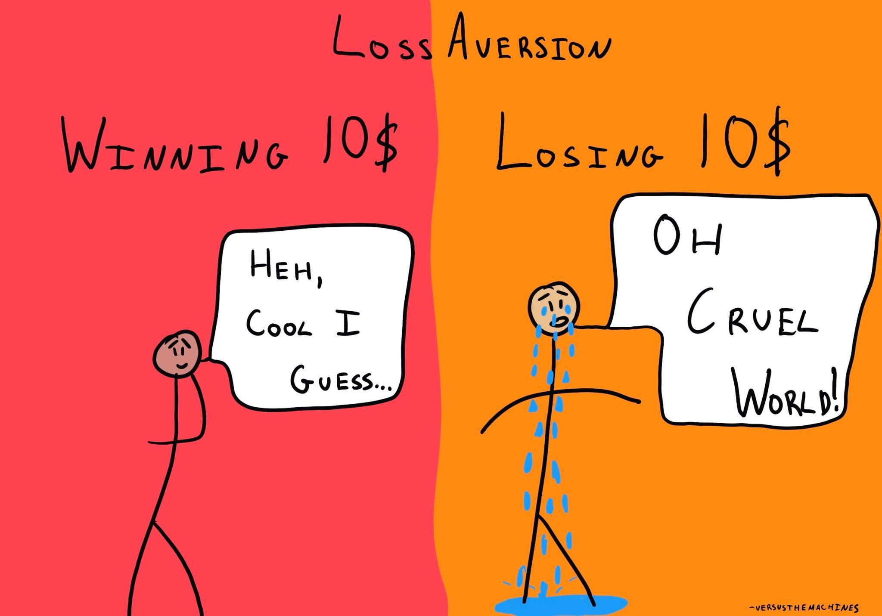
Loss aversion
Human beings experience losses asymmetrically more severely than equivalent gains
This overwhelming fear of loss can cause investors to behave irrationally and make bad decisions.
Negativity Bias

Slide 66
The pain of losing is psychologically twice as powerful as the pleasure of gaining
The fear of incurring losses can prevent us from taking even well-calculated risks, with potential for worthwhile returns.
Since decisions are influenced by an emotional reaction loss aversion is a result of System 1 thinking.

Slide 67
Loss aversion → Sunk cost fallacy.
People will take further risks to try and recover from a bad investment that has already happened.
We may feel that our past investment will be ‘lost’ if we don’t follow through on the decision, and make a decision based on loss aversion rather than consider the benefits that would be gained if we did not continue our commitment.

